Slide 1
Introduction to SPSS
https://stats.idre.ucla.edu/spss/seminars/notes/

Slide 2
Outline
Objective: to show you common data management utilities in SPSS to facilitate your data analysis
Strength of SPSS: focus on point and click
SPSS Environment
Get familiar with various elements of SPSS
Entering Data
How to get data into SPSS
Exploring Data
Run basic descriptive analysis to understand your data
Modifying Data
Variables is messy, get it to where you want
Managing Data
Reducing your data, adding more data, combining multiple datasets

Slide 3
Requirements
SPSS version 22 (slides are of SPSS 26) or higher installed
CLICC Virtual Desktop (https://docs.library.ucla.edu/display/LSD/Access+a+CLICC+Virtual+Desktop )
Download the complete set of files here:
SPSS Environment
https://stats.idre.ucla.edu/wp-content/uploads/2016/08/elemapiv2.sav
Main seminar
https://stats.idre.ucla.edu/wp-content/uploads/2017/01/spss-notes.zip

Slide 4
SPSS Environment
Data View
Variable View
Syntax Editor
Command Syntax
Output (Viewer)

Slide 5
Data View

Slide 6
Variable View

Slide 7
Syntax Editor
Show pasting syntax

Slide 8
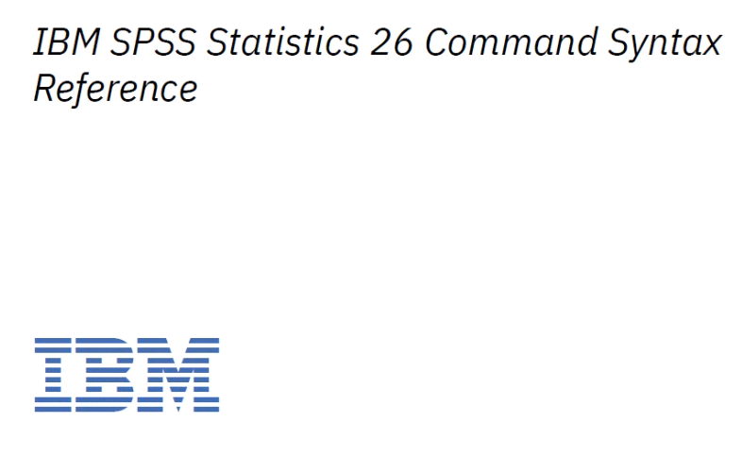
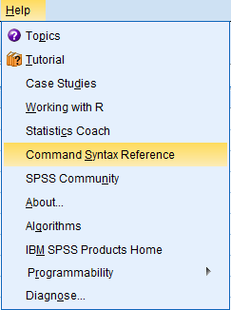
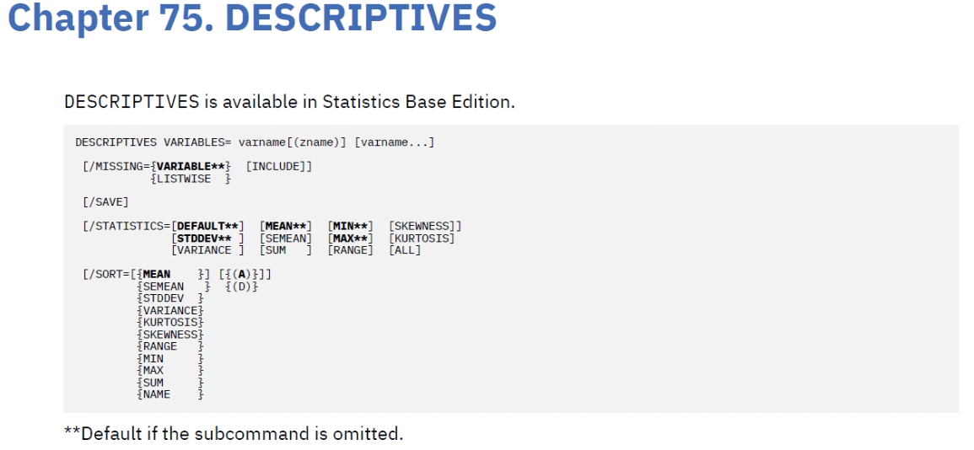
Command Syntax

Slide 9
Output Window (Viewer)

Slide 10
Entering Data
Reading in an Excel or CSV
Open SPSS Data
Missing Data

Slide 11
Reading in Excel Data

Slide 12
Reading in CSV Files

Slide 13
Reading in SPSS Files

Slide 14
Opening Data
You can use SPSS as StatTransfer

Slide 15
Import Data

Slide 16
Exercise 1
Use the import data feature to open hs0.csv then save the file as myhs0.sav
Do you see any differences from Open File?
What is the benefit of saving as SAV?

Slide 17
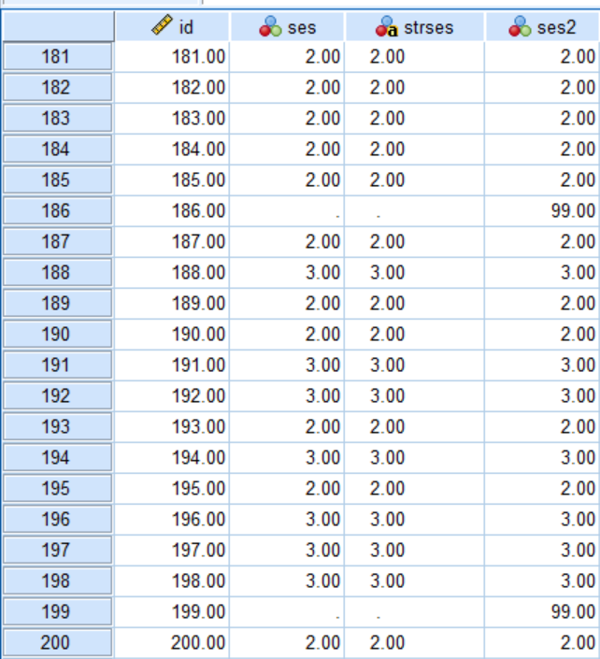
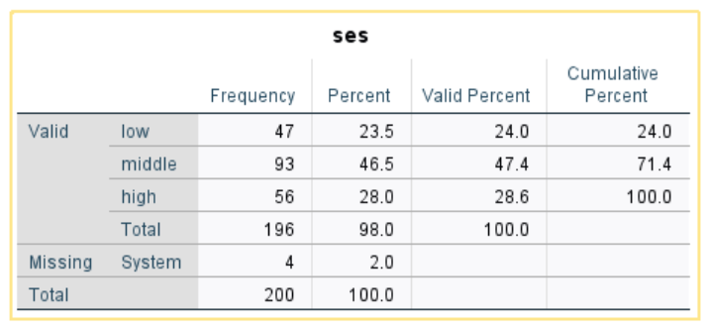
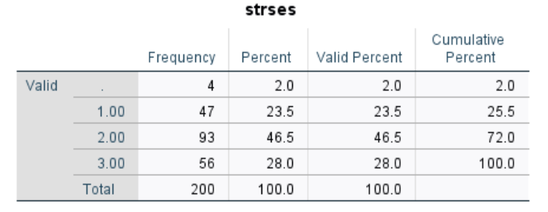
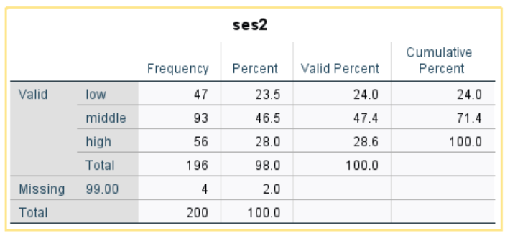
Missing Data in SPSS
SYSMIS
?
USER MISS

Slide 18
True / False #1
1. For a numeric variable, System Missing is represented by a dot and User Missing is represented by a number.
2. For string variables, SYSTEM MISSING is represented by a dot.
3. User Missing allows multiple types of missingness, whereas SYSTEM MISSING allows only one type.

Slide 19
Exploring Data
Descriptives
Stratified
Conditional descriptives
Histograms
Correlations
Scatterplots

Slide 20
Open hs0.sav

Slide 21
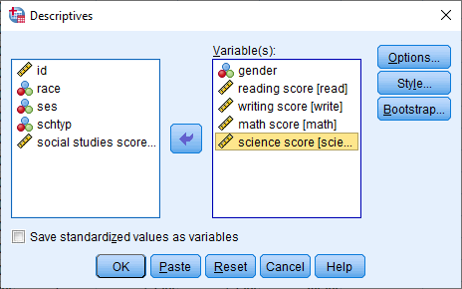
Descriptive Statistics

Slide 22
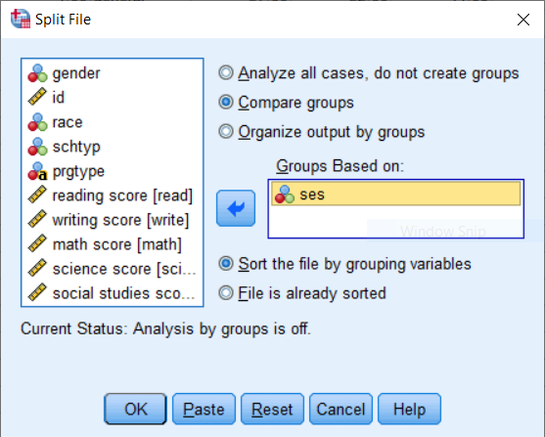
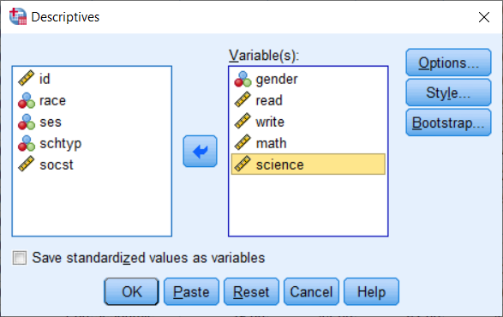
Stratified Descriptives

Slide 23
Stratified Descriptives
Why would you see different N’s
and what is Valid N?
What does mean indicate for gender?

Slide 24
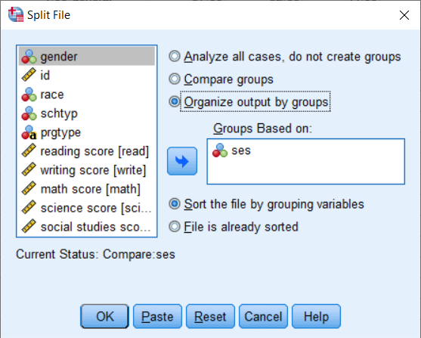
Exercise 2
Try running the same analysis but select Organize output by groups
Which do you prefer?

Slide 25
Remember to turn off split file

Slide 26
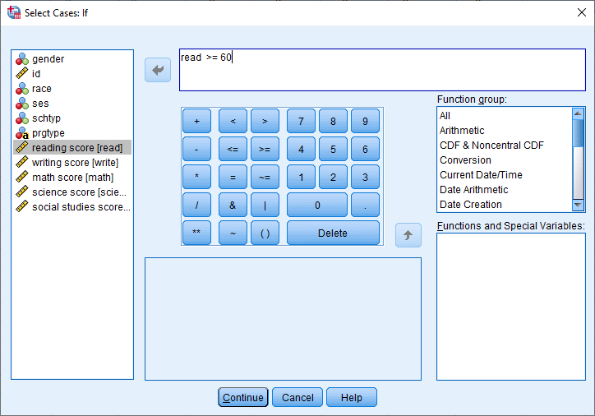
Conditional Select
Suppose 60 is a passing score on reading and you want to see
how many students passed

Slide 27
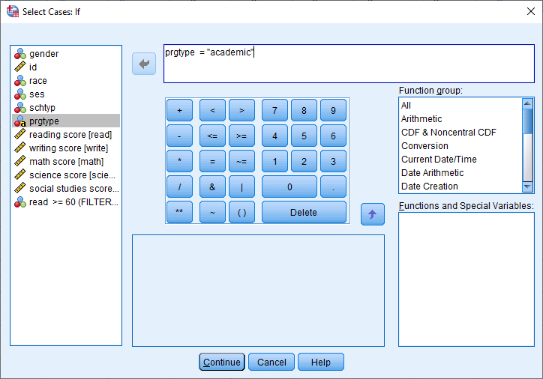
Conditional Select (String Variable)
Want to see a particular type of school. Why is it in “quotes”? How would you change it if it’s numeric?

Slide 28
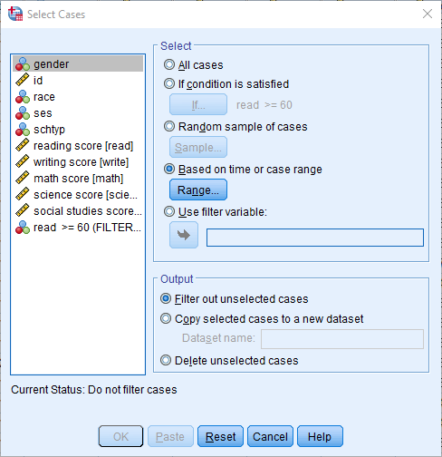
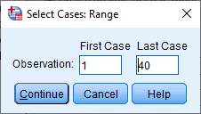
Conditional Select (Range)
Suppose 60 is a passing score on reading and you want to see
how many students passed

Slide 29
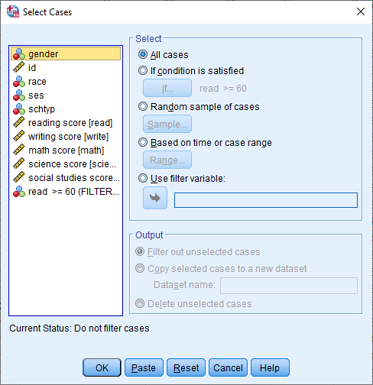
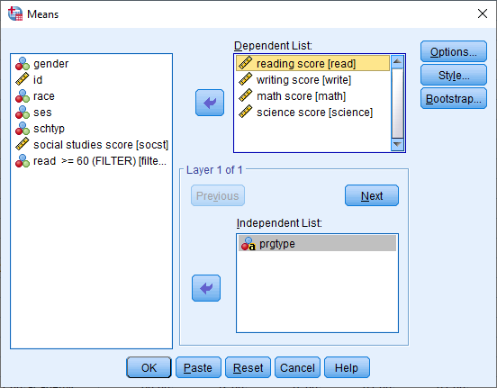
Compare means

Slide 30
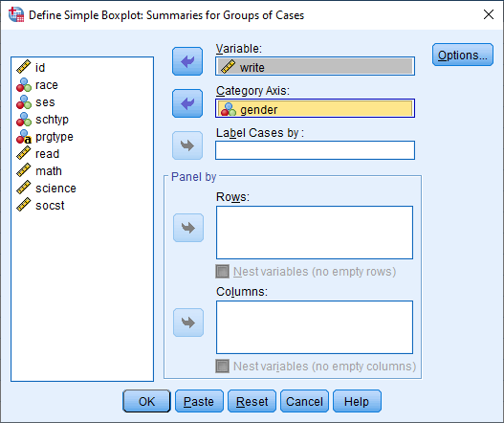
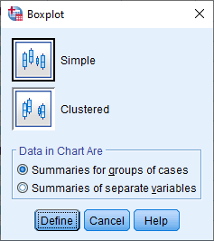
Boxplot

Slide 31
(Univariate) Boxplot
Upper fence
75th percentile
Variable
Median
25th percentile
Lower fence
Male
Female
Value labels would be useful here
Category axis

Slide 32
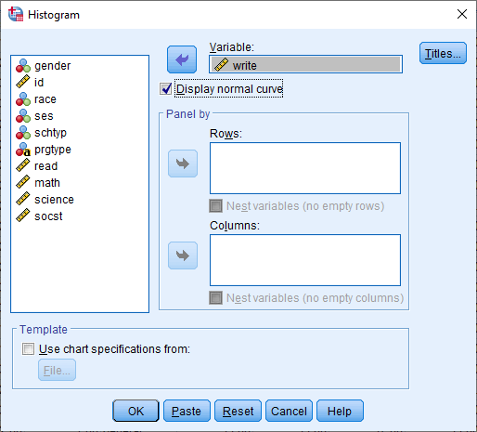
(Univariate) Histogram

Slide 33
Histogram of writing score
What does the bell shape black line represent?

Slide 34
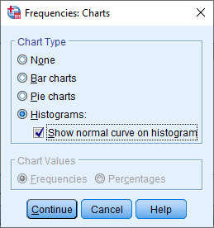
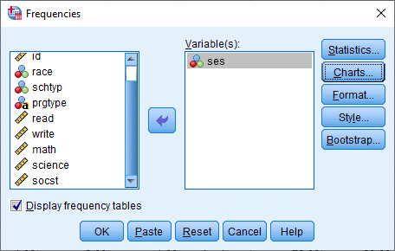
Frequency of SES + Histogram

Slide 35
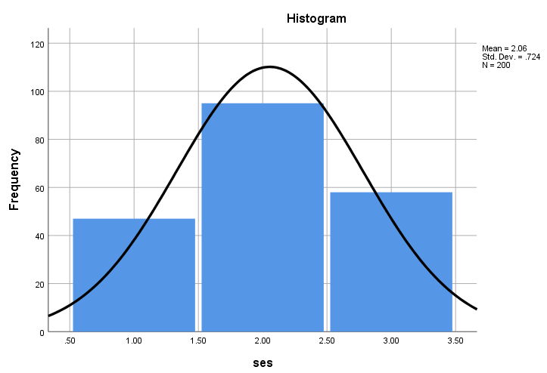
Frequency + Histogram of SES
Do we expect this distribution to be normal?

Slide 36
Exercise 3
Create a histogram of writing scores for females and males.
Hint: Panel by columns
Map it onto the barplot.

Slide 37
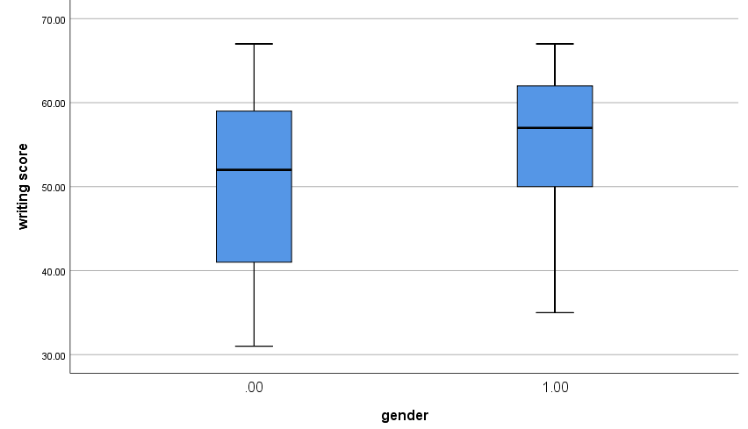
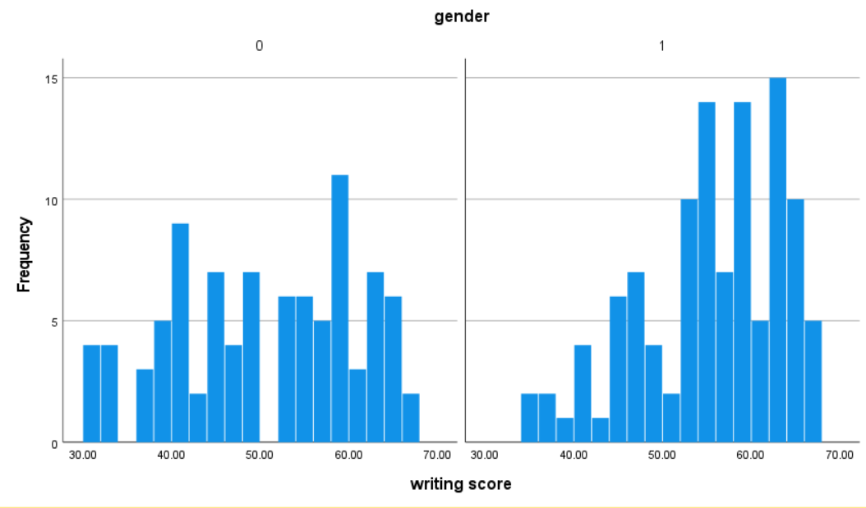
Exercise 3 (solution)
Male
Female

Slide 38
Challenge
Recreate descriptives to represent the barplot (obtain the median, 25th percentile and 75th percentile)

Slide 39
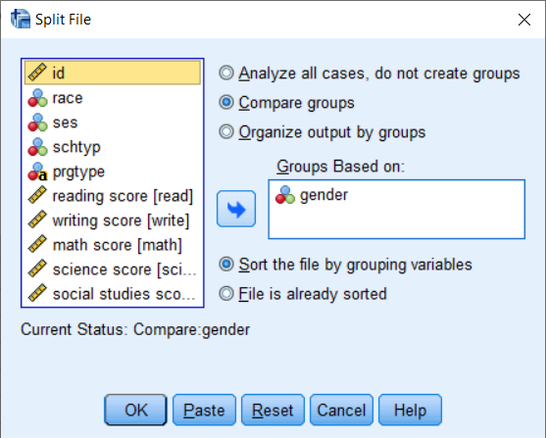
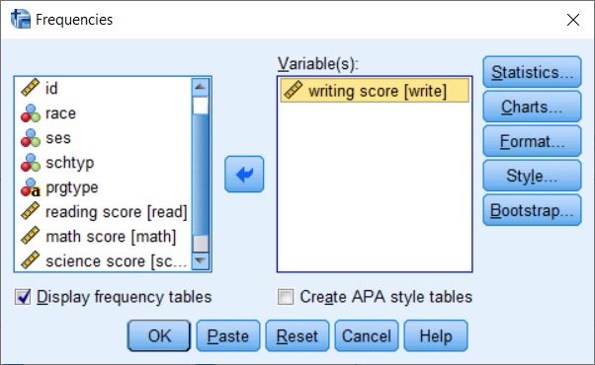
Challenge (solution steps)

Slide 40
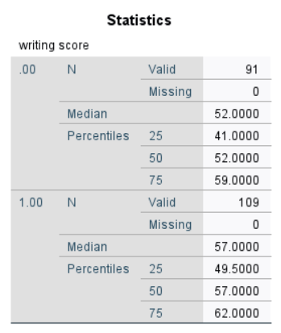
Challenge (solution)

Slide 41
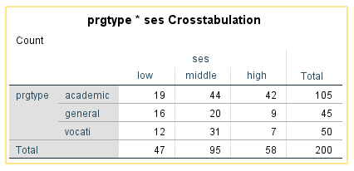
(Bivariate) Crosstabulations
What kind of variable is this?
Useful for tabulating two categorical variables

Slide 42
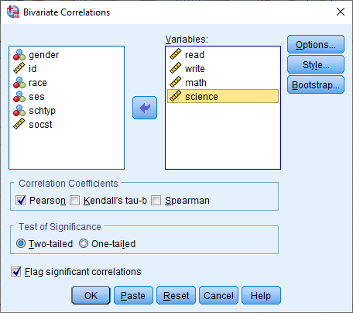
(Bivariate) Correlations
Useful for summarizing two continuous variables
What do you notice about
the measurement of these variables?

Slide 43
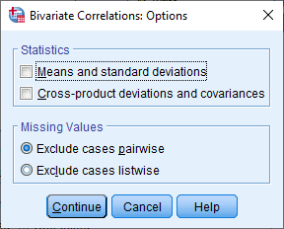
Listwise Deletion (Correlation)

Slide 44
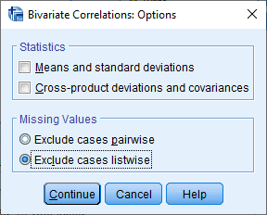
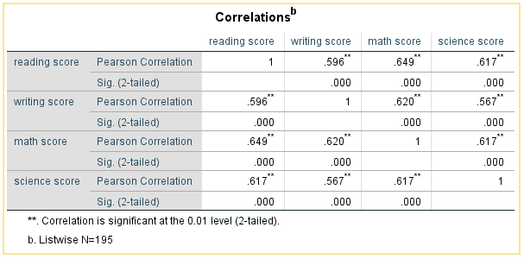
Pairwise Deletion (Correlation)

Slide 45
True/False #2 (Poll)
1. A significant correlation implies you have a high correlation
2. Listwise deletion deletes all missing data before running the analysis
3. Assume all variables have missing data. The more variables you put into the bivariate correlation, the smaller the sample size after listwise deletion.

Slide 46
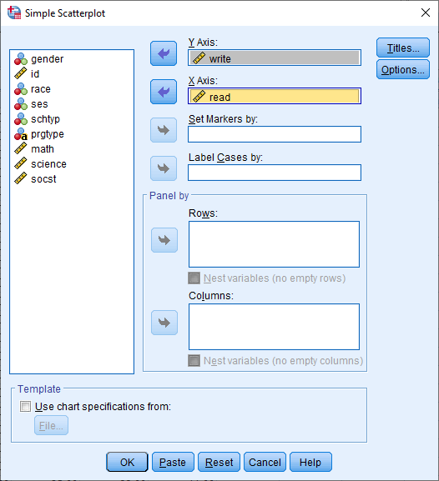
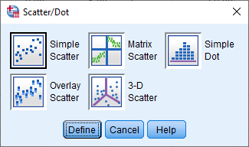
(Bivariate) Scatterplot
Purpose: to visualize bivariate relationships

Slide 47
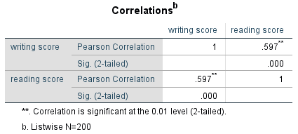
Read vs. Write

Slide 48
Exercise 4
Create a scatterplot of write on the x-axis and read on the y-axis.
Do you expect the results to the different?

Slide 49
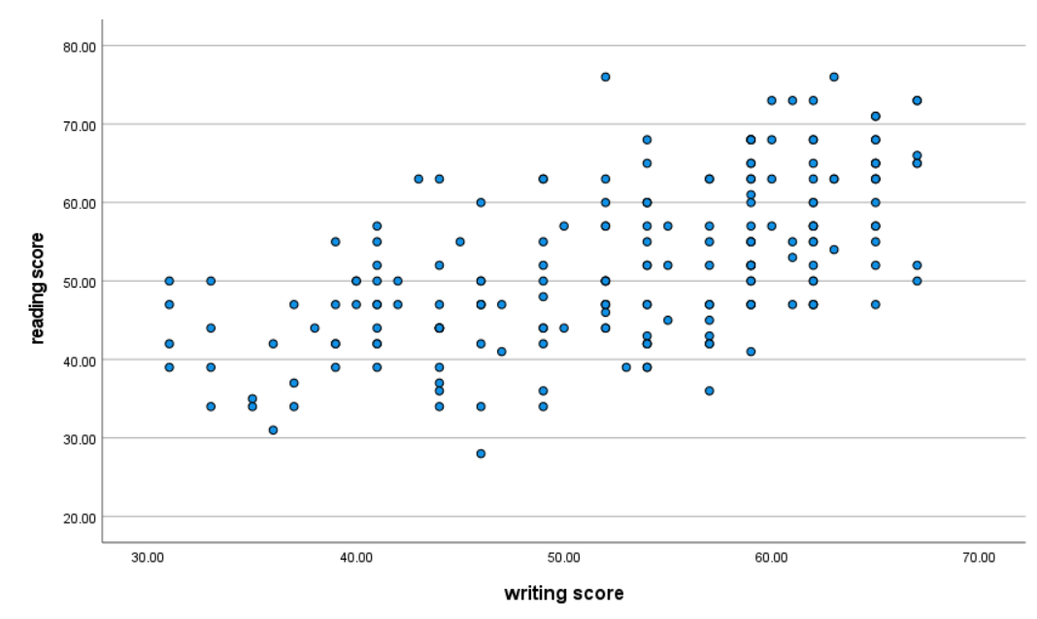
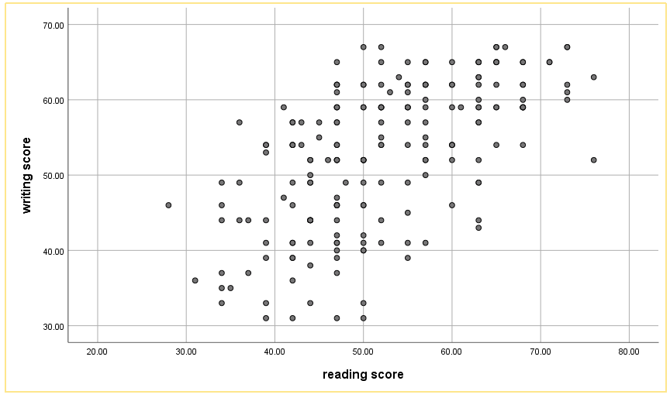
Exercise 4 (solution)
Is the relationship still positive?
(31,50)
(50,31)

Slide 50
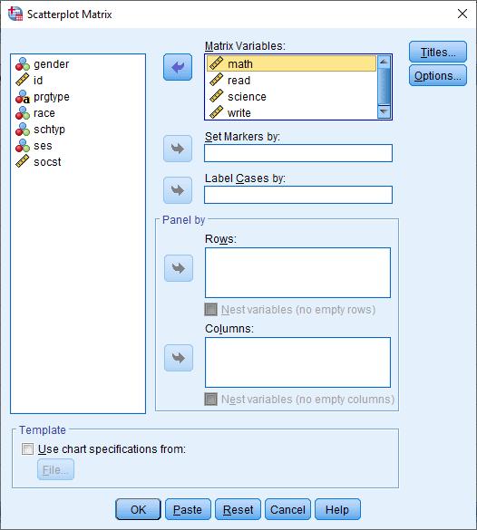
(Bivariate) Matrix Scatterplot

Slide 51
Exercise 5
Match the matrix plot to the scatterplots we made before and compare to the correlation table
What other analysis represents this matrix?

Slide 52
Exercise 5 (solution 1)
Matched to scatterplot
What other analysis represents this matrix?

Slide 53
Exercise 5 (solution 2)
Matched to correlation table
What other analysis represents this matrix?

Slide 54
Modifying Data
Reordering
Variable / value labels
String to numeric
Renaming
Recoding
New variables
Functions

Slide 55
Open hs0.sav

Slide 56
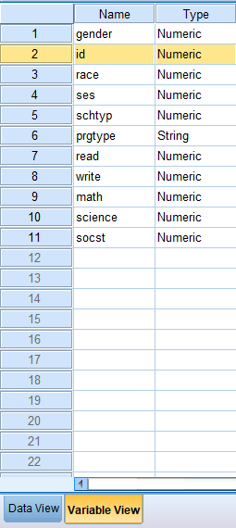
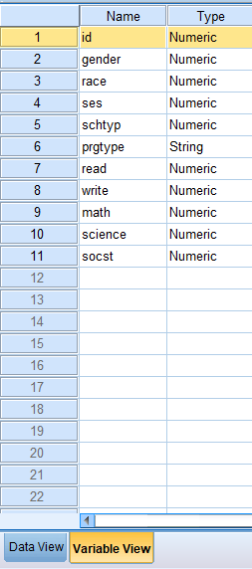
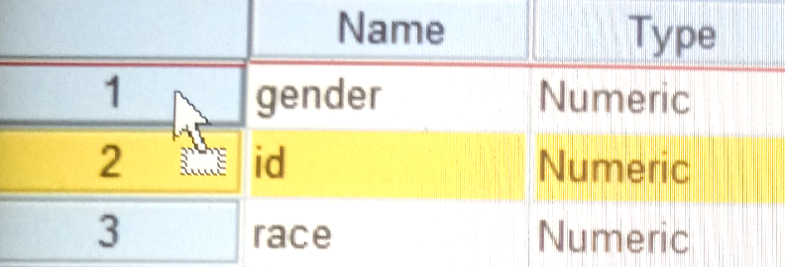
Reordering Variables

Slide 57
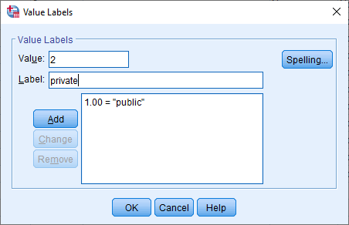
Adding variable and value labels

Slide 58
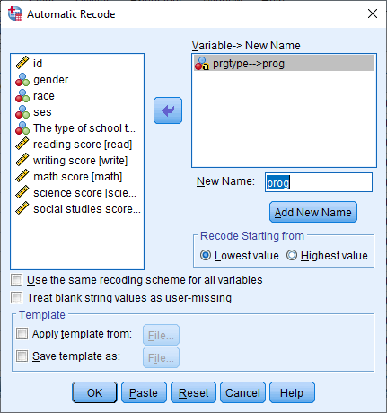
String to Numeric
Might be useful!

Slide 59
String to Numeric (add label)

Slide 60
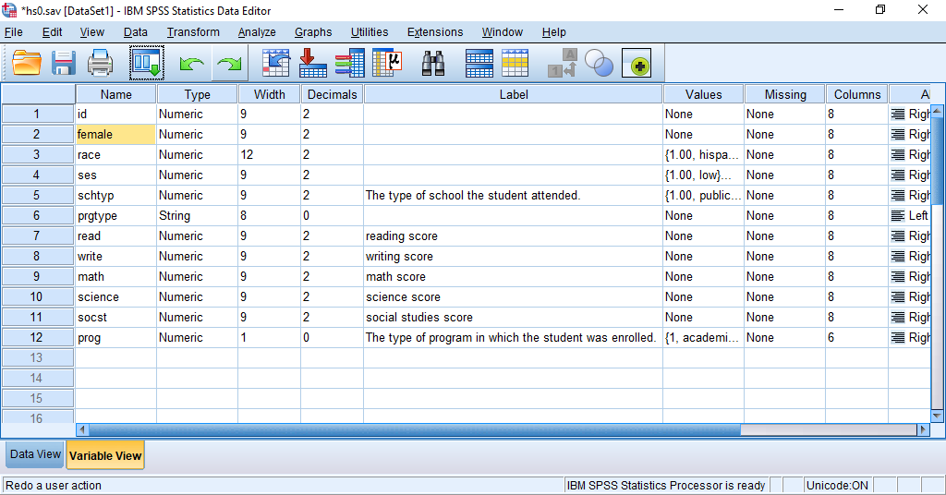
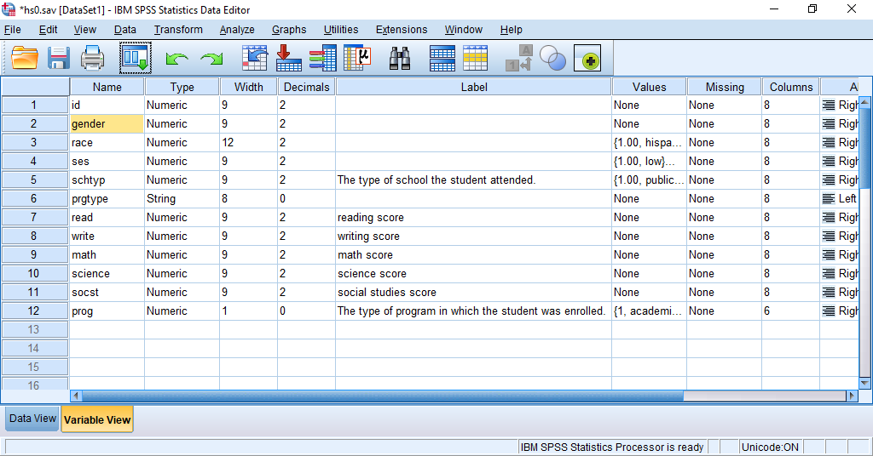
Renaming Variables

Slide 61
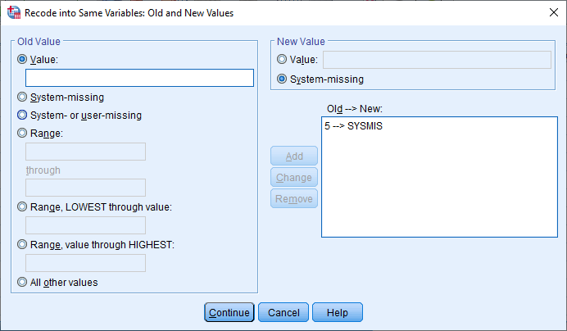
Recoding Values
We know what this is now!
Suppose 5 is “unknown”.

Slide 62
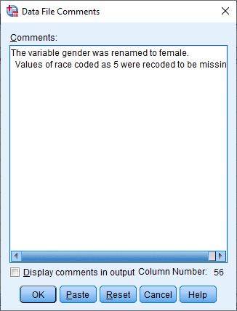
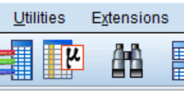
Data File Comments
Research reproducibility

Slide 63
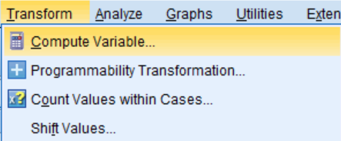
Creating a new variable

Slide 64
Get descriptives of new “total”

Slide 65
Exercise 6
Open missing.sav
Convert strses to a numeric variable called numses and recreate ses2
Notice what it does to the missing values
Hint: you may need to do more than one step
Run descriptives to check

Slide 66
How missing data affects the sum

Slide 67
Recoding grade
(0,80] → 0
(80,110] → 1
(110,140] → 2
(140, 170] → 3
(170, 300] → 4

Slide 68
Make sure to add value labels

Slide 69
Check frequencies

Slide 70
Include or exclude?
(80,110] → 1 (D)
OR
[80,110) → 1 (D)
??
Suppose the teacher were mean. How would we make 110 into 0 (F)?

Slide 71
Standardize Variables
How would you recreate using COMPUTE?
Hint:
Z = (Observation – Mean) / Standard Deviation

Slide 72
Exercise 7
The Z-score is defined as (SCORE-MEAN)/(STANDARD DEVIATION)
Try to recreate the Z-score manually. The descriptives are given below.
What is the mean and standard deviation of Z-score you created?

Slide 73
Exercise 7 (solution)

Slide 74
Functions

Slide 75
Using functions (aggregate)

Slide 76
Checking if we did it correctly
Should get a different mean for each SES
See if you can recreate the ordering of this dataset.

Slide 77
Row Mean

Slide 78
Exercise 8
Create a new variable called row_mean2 that takes the average of
read, write, math and science without using the mean() function.
What do you notice? What assumptions are you making when you use the mean() function?

Slide 79
Exercise 8 (solution)

Slide 80
Managing Data
Subset cases
Subset variables
Appending
Merging

Slide 81
Open hs1.sav

Slide 82
Select cases
Careful with “Delete unselected cases”

Slide 83
Open hs1.sav

Slide 84
Keep certain variables
Save As “hskept.sav”
When would you need to do this?

Slide 85
Open hsmale.sav

Slide 86
Appending (Add cases)
Same variable names and number of variables
+
→
Same variable names and number of variables

Slide 87
Add cases (females)

Slide 88
Merging
Different number of variables and variable names
+
Same key variable
Same key variable
→

Slide 89
Open hsdem.sav

Slide 90
Open hstest.sav

Slide 91
Merge hsbdem.sav → hstest.sav
If hstest.sav is not open

Slide 92
Merge (2)
hsdem.sav
hstest.sav

Slide 93
Exercise 9
Open the original hsdem.sav and hstest.sav.
What does the missing data mean?

Slide 94
Exercise 9 (solution)
hsdem.sav
hstest.sav
Missing ID 10
Missing ID 4

Slide 95
True/False #3
1. T/F Merging is appropriate when you want to add cases
2. T/F Appending is appropriate when you have two datasets with the same number of variables with the same variable names

Slide 96
Conclusion
At this point, you’ve learned how to use SPSS’ point and click interface to:
1. Get data into SPSS
2. Run descriptives on your data
3. Create visualizations of your data
4. Modify variables to create sum scores and categorical variables (grades)
5. Add more cases (append rows), merge new data (adding columns)

Slide 97
Thank you!
Your feedback is greatly appreciated
https://bit.ly/2GyUcgi

