Slide 1
Decomposing, Probing, and Plotting Interactions in Stata (Part II + Lab)
https://stats.idre.ucla.edu/stata/seminars/interactions-stata/

Slide 2
Requirements
Basic notions of linear regression
Stata installed
https://docs.library.ucla.edu/display/LSD/Access+a+CLICC+Virtual+Desktop
Dataset loaded into Stata
use https://stats.idre.ucla.edu/wp-content/uploads/2020/06/exercise, clear
Create value labels
label define progl 1 "jog" 2 "swim" 3 "read"
label define genderl 1 "male" 2 "female"
label values prog progl
label values gender genderl
Download the complete Stata code here:
https://stats.idre.ucla.edu/wp-content/uploads/2020/07/interactions20200724.do

Slide 3
Outline
Content to cover today
Lecture: Categorical by categorical
Exercises: covering each section
Bonus Lecture: Three-way interaction (if time allows)

Slide 4
Categorical by Categorical
Model
Simple effects
Plotting

Slide 5
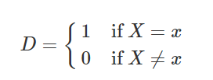
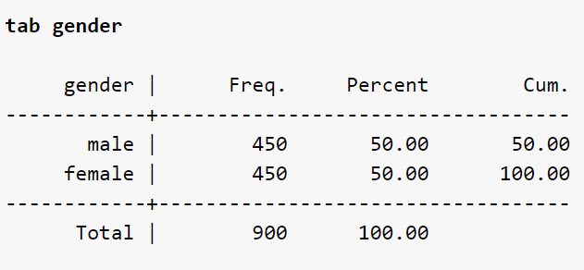
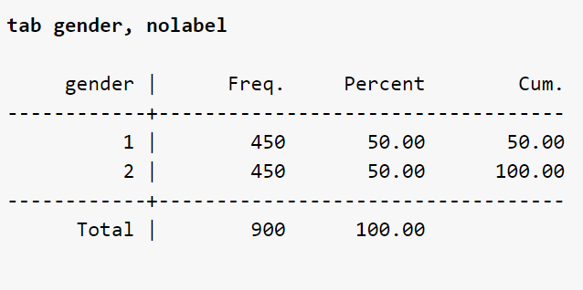
Dummy coding (2 categories)
$$D_{male}=1 if Gender=male$$
$$D_{male}=0 if Gender=female$$
Note: only $k−1$ dummy codes are required in the regression model
e.g., For gender, $k=2$ so only 1 dummy code is required
ib2.gender
DMALE = 0 if Gender = 2
DMALE = 1 if Gender = 1

Slide 6
Dummy Coding (3 categories)
Does type of exercise (W) moderate the gender effect (X)?
do males and females lose weight differently depending on the type of exercise
$$D_{male}=1 if Gender=male$$
only k-1 needed, k=2
$$D_{male}=0 if Gender=female$$
$$D_{jog}=1, D_{swim}=0 if Prog=jog$$
$$D_{jog}=0, D_{swim}=1 if Prog=swim$$
only k-1 needed, k=3
$$D_{jog}=0, D_{swim}=0 if Prog=read$$
$$D_{jog}=1, D_{swim}=1 if Prog= ?$$

Slide 7
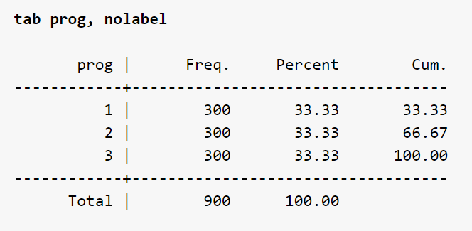
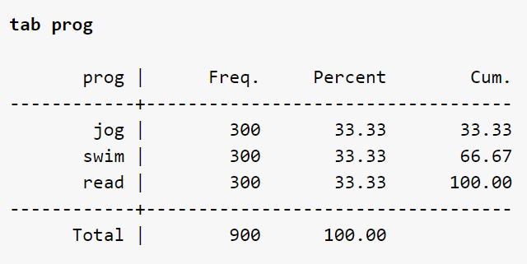
Value labels
Recall
Stata i. notation
Gender = 2 reference
Female
Verify
DMALE
Prog = 3 reference
Reading
DJOG, DSWIM

Slide 8
Quiz #10
True or False
When we specify ib2.prog Stata internally creates two dummy variables for Categories 1 and 3

Slide 9
Cat x Cat Model
Equivalent to:
must have i. notation or Stata will think the variable is continuous

Slide 10
Model Interpretation (Cat x Cat)
b0 _cons: intercept or the predicted weight loss when Dmale=0 and Djog=0,Dswim=0 (i.e., reading females)
b1 male: simple effect of males for Djog=0,Dswim=0 (i.e., male – female weight loss in reading)
b2 jog: simple effect of jogging when Dmale=0 (i.e., difference in weight loss between jogging vs reading for females)
b3 swim: simple effect of swimming when Dmale=0 (i.e., difference in weight loss between swimming vs reading for females)

Slide 11
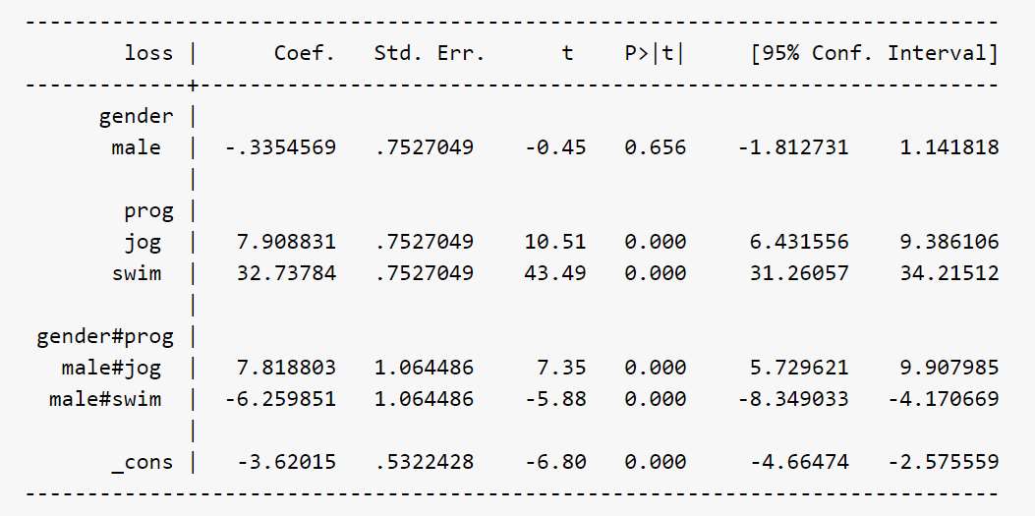
Model Interpretation (Cat x Cat)
b4 male#jog: interaction of Dmale and Djog, the male effect (male – female) in jogging vs the male effect in reading. Also, jogging effect (jogging – reading) for males vs the jogging effect for females
b5 male#swim: interaction of Dmale and Dswim, the male effect (male – female) in swimming vs male effect in reading. Also, swimming effect (swimming- reading) for males vs the swimming effect for females

Slide 12
Interaction as the additional effect
male+male#jog male effect for jogging
b1 male: male effect (male – female) weight loss in reading
b4 male#jog: male effect (male – female) in jogging vs the male effect in reading, (i.e., additional effect of jogging)
male+male#swim male effect for swimming
b5 male#swim: male effect (male – female) in swimming vs male effect in reading, (i.e., additional male effect for swimming)

Slide 13
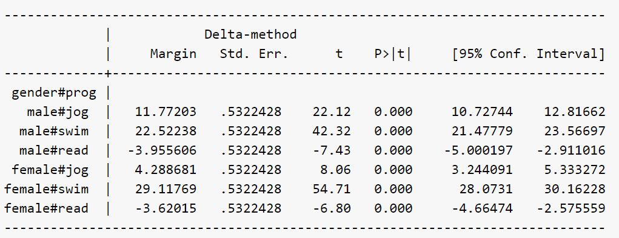
Predicted Values (cat x cat)
categorical predictors come before comma (not an option)

Slide 14
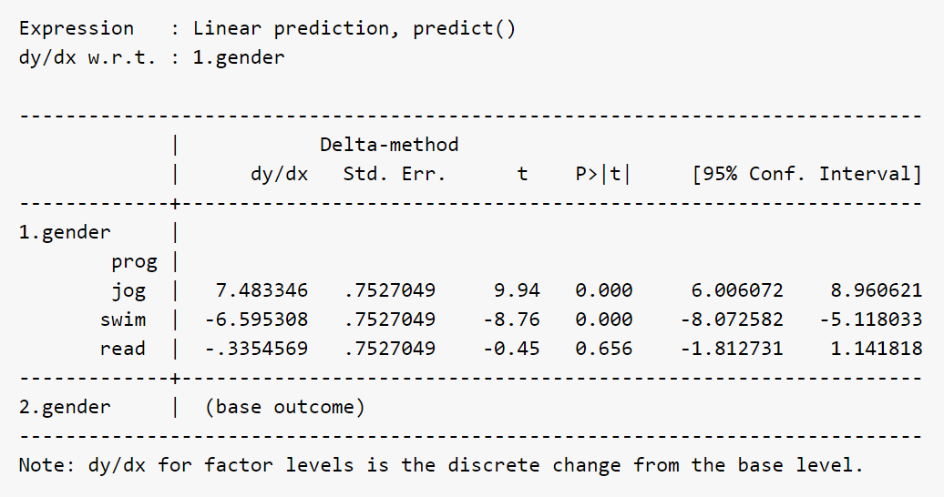
Simple effects not = interaction (cat x cat)
Even though gender is a categorical variable we must specify dydx after comma
Simple male effects
reference group, ib2.gender

Slide 15
Interaction = Difference of Simple Effects (continued)
Male effect swimming
Male effect reading
Male swim – Male read
-6.595 – (-.3354) = -6.259
Difference of simple effects
male+male#swim male effect for swimming
Additional effect

Slide 16
Quiz #11, 12
True or False
Compare to the Stata command regress loss ib2.gender##ib3.prog. Equivalent syntax is regress loss gender prog ib2.gender#ib3.prog.
The interaction male#jog is the male effect for the jogging condition.

Slide 17
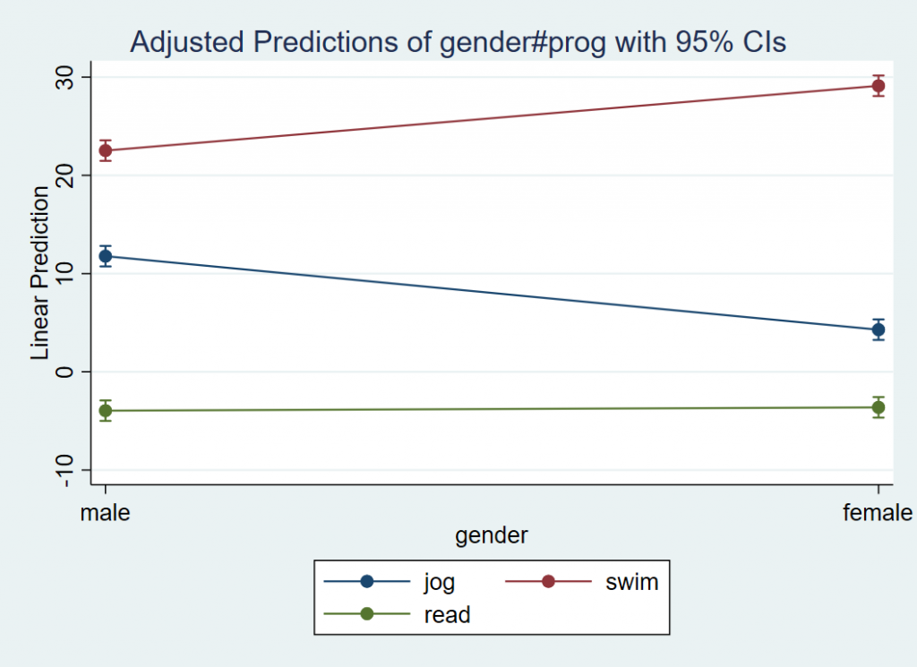
Plotting cat x cat interaction
both categorical so comes before comma
x-axis
separate lines

Slide 18
Quiz #13,14
True or False
The code margins prog#gender tells marginsplot that we want prog on the x-axis with lines corresponding to levels of gender.
Multiple Choice
How would we plot exercise type (prog) along the x-axis split by gender?

Slide 19
Answers to Quiz Questions
10. T
11. F, Without the i. prefix for the simple effects, Stata treats gender and prog as continuous variables despite the correct ib#. specification in the interaction term.
12. F, The male jogging effect alone does not capture the interaction. The interaction is the difference of simple effects.
13. T
14. Answer 1

Slide 20
Exercises
Introduction
Continuous by Continuous
Continuous by Categorical
Categorical by Categorical

Slide 21
Introduction
1. Plotting
2. Simple slopes

Slide 22
Exercise 1
Refer to the following command
What would the plot look like if you replaced the first command with
margins, dydx(hours)?
Answer is on the next slide.

Slide 23
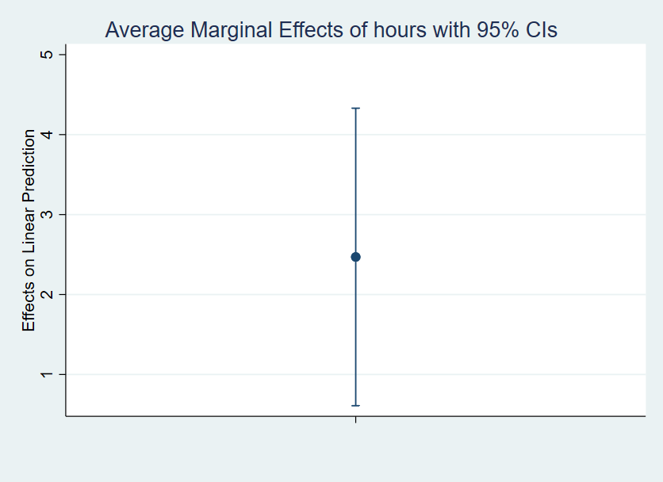
Exercise 1 (solution)
4.32
2.48
0.609

Slide 24
Exercise 2
Predict two values of weight loss for Hours = 10 and Hours = 20 using at, then calculate the slope by hand.
How do the results compare with dydx?
Answer is on the next slide.

Slide 25
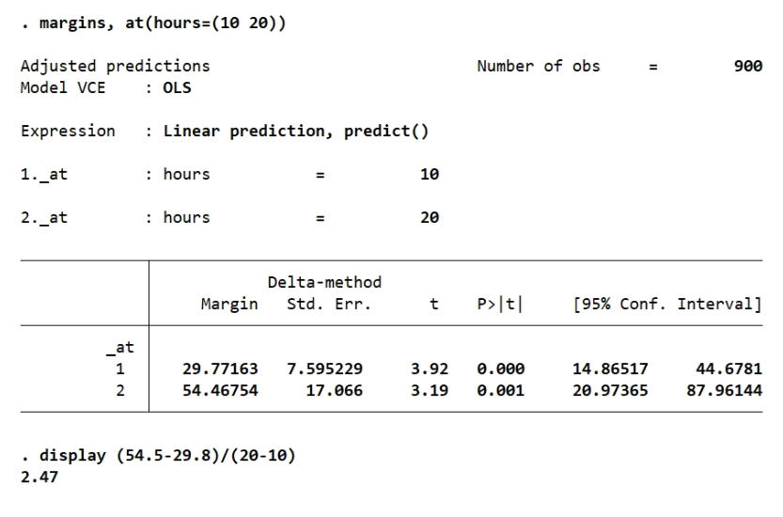
Exercise 2 (solution)

Slide 26
Continuous by Continuous
3. Deriving the interaction term using predicted values
4. Deriving the interaction using pwcompare
5. Testing differences in predicted values

Slide 27
Exercise 3 (a)
Obtain predicted values for the following values and store the results into global variables y00, y10, y01,y11
Hours = 0, Effort = 0 (y00)
Hours = 1, Effort = 0 (y10)
Hours = 0, Effort = 1 (y01)
Hours = 1, Effort = 1 (y11)
The following exercise will guide you through deriving the interaction term using predicted values.
Refer to the following model:
regress loss c.hours##c.effort
$${\hat{WeightLoss}|}_{Hours=0, Effort=0}$$
$${\hat{WeightLoss}|}_{Hours=1, Effort=0}$$
$${\hat{WeightLoss}|}_{Hours=0, Effort=1}$$
$${\hat{WeightLoss}|}_{Hours=1, Effort=1}$$

Slide 28
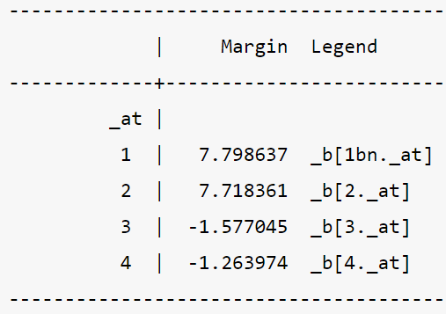
Exercise 3 (b)
First, store into margins
Second, assign global variables
margins, at(hours=(0 1) effort=(0 1)) post coeflegend
global y00 = _b[1bn._at]
global y01 = _b[2._at]
global y10 = _b[3._at]
global y11 = _b[4._at]
display $y00,$y01,$y10,$y11
$${\hat{WeightLoss}|}_{Hours=0, Effort=0}$$
$${\hat{WeightLoss}|}_{Hours=1, Effort=0}$$
$${\hat{WeightLoss}|}_{Hours=0, Effort=1}$$
$${\hat{WeightLoss}|}_{Hours=1, Effort=1}$$

Slide 29
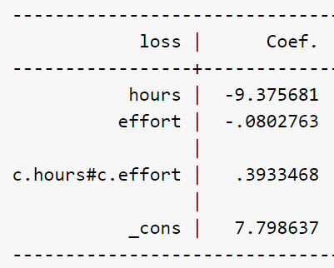
Exercise 3 (c)
2. Take the following differences. What coefficients do these difference correspond to in regress loss c.hours##c.effort?
(Hint: one of the differences is a sum of two coefficients)
y10 – y00
y11 – y01
$${\hat{WeightLoss}|}_{Hours=1, Effort=0}−{\hat{WeightLoss}|}_{Hours=0, Effort=0}$$
Slope of hours at Effort = 0
$${\hat{WeightLoss}|}_{Hours=1, Effort=1}−{\hat{WeightLoss}|}_{Hours=0, Effort=1}$$
Slope of hours at Effort = 1
Stata command:
display $y10-$y00, $y11-$y01

Slide 30
Exercise 3 (d)
3. Take the simple slope of Hours at Effort = 1 minus the simple slope of Hours at Effort = 0. Which coefficient does this correspond to in regress loss c.effort##c.hours?
Stata command:
display ($y11-$y01)-($y10-$y00)
Interaction is the change in the slope of Hours for a one-unit increase in Effort

Slide 31
Exercise 3 (Solution)
display $y00,$y01,$y10,$y11
7.7986369 7.7183605 -1.5770445 -1.2639741
display $y10-$y00, $y11-$y01
-9.3756814 -8.9823346
Simple slope of Hours at Effort = 0
Simple slope of Hours at Effort = 1
Additional slope of Hours for Effort = 1
display ($y11-$y01)-($y10-$y00)
.3933468
Interaction of c.hours#c.effort

Slide 32
Exercise 4
Refer to the following model:
Recreate the interaction using margins and pwcompare
regress loss c.hours##c.effort
Answer is given on the next slide.

Slide 33
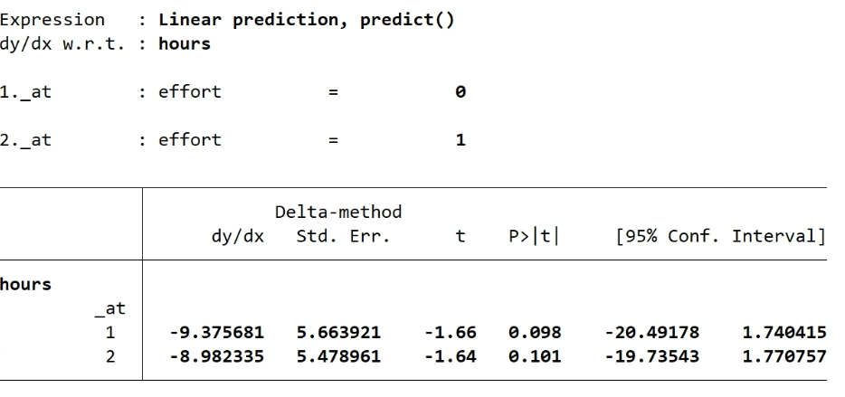
Answer to Exercise 4 (a)
margins, dydx(hours) at(effort=(0 1))
-8.982- (-9.376) = 0.394

Slide 34
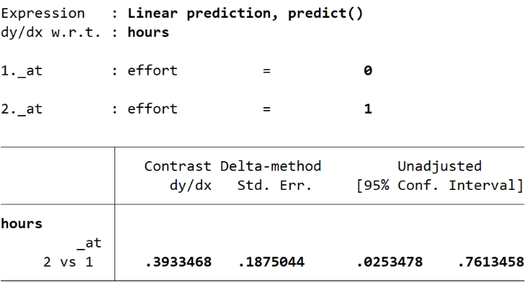
Answer to Exercise 4 (b)
margins, dydx(hours) at(effort=(0 1)) pwcompare

Slide 35
Exercise 5
Refer to the following model:
regress loss c.hours##c.effort
Estimate the difference in Weight Loss for Low versus High levels of Effort at Hours=0. What is the actual value from Stata? Verify with a plot.
Run this code first
summarize effort
return list
global effa = round(r(mean) + r(sd),0.1)
global eff = round(r(mean),0.1)
global effb = round(r(mean) - r(sd),0.1)
display $effa
display $effb

Slide 36
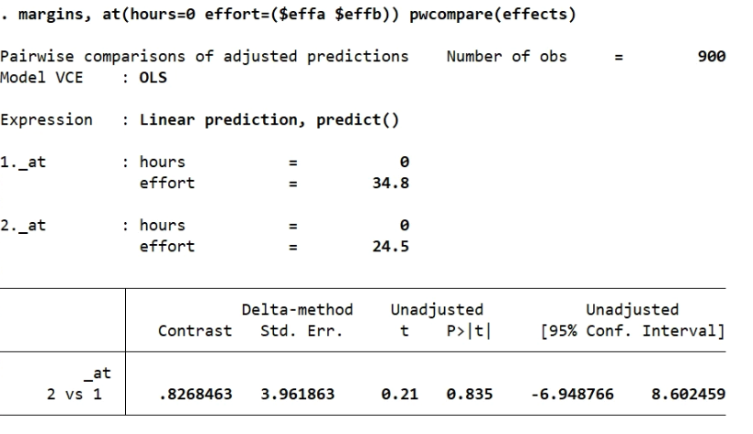
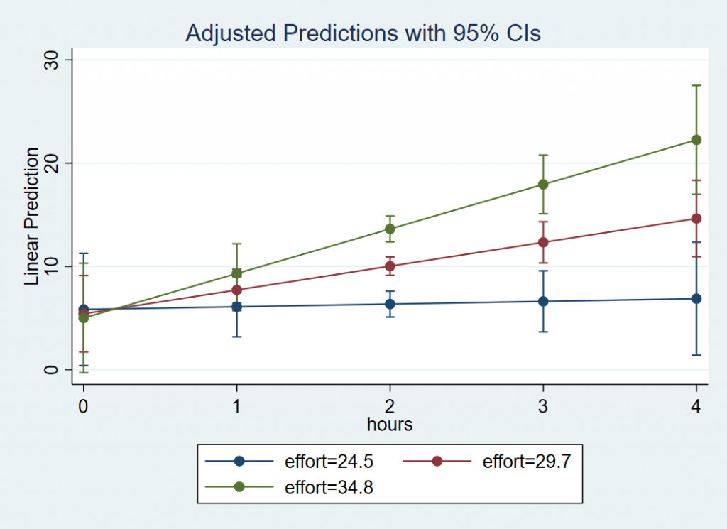
Exercise 5 (Solution)
margins, at(hours=0 effort=($effa $effb)) pwcompare(effects)

Slide 37
Continuous by Categorical
6. Releveling the reference group

Slide 38
Exercise 6
Refer to the following model:
regress loss c.hours##ib2.gender
Relevel gender using ib#. so that male is now the reference group.
Refit the regress model for Weight Loss with the interaction of Hours by Gender
Use margins to obtain the simple effects.
a) Spell out the new regression equation using a dummy code for gender.
b) Interpret each coefficient in the new model.
c) What is the main difference in the output compared to using Dmale? What does the naming convention in the coefficient table represent?

Slide 39
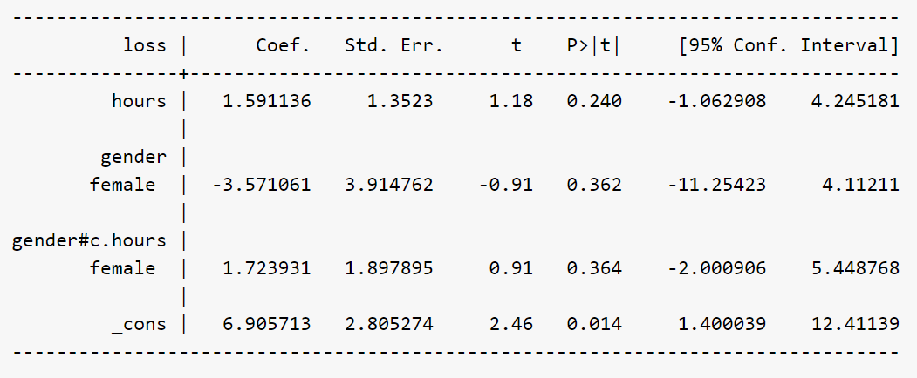
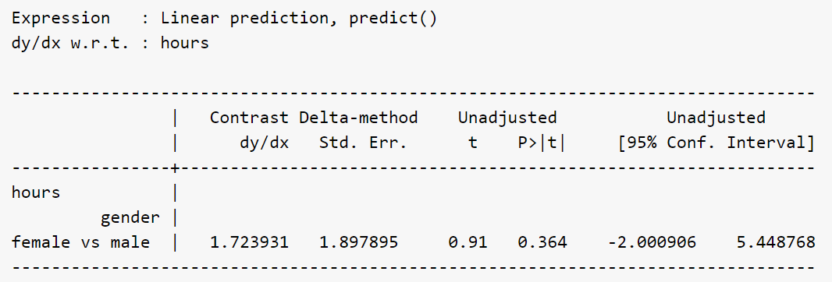
Exercise 6 (Solution 1)
a)
regress loss c.hours##ib1.gender
margins gender, dydx(hours) pwcompare
c) The sign is flipped -1.723931
The omitted group male is now the reference group

Slide 40
Exercise 6 (Solution 2)
b)
b0 _cons: the intercept, or the predicted weight loss when Hours = 0 in the reference group of Gender, which is Dfemale=0 or males
b1 hours: simple slope of Hours for the reference group Dfemale=0 or males.
b2 female: simple effect of Gender or the difference in weight loss between females and males at Hours = 0.
b3 gender#c.hours: the interaction of Hours and Gender, the difference in the simple slopes of Hours for females versus males
b3 is also the additional hours slope for females
b1+ b3 is the slope of hours for females

Slide 41
Categorical by Categorical
7. Reproduce predicted values
8. Reproduce interaction

Slide 42
Exercise 7 (a)
Refer to the following model:
regress loss i.gender i.prog ib2.gender#ib3.prog, coeflegend
regress loss ib2.gender##ib3.prog, coeflegend
Try to reproduce each predicted value from margins using the coefficient table.
Do you notice a pattern for the coefficient terms?
(coefficient table and margins presented on the next slide)

Slide 43
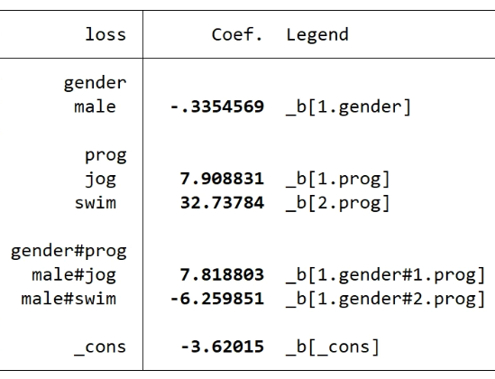
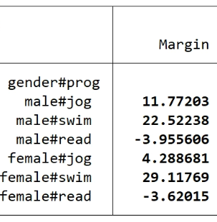
Exercise 7 (b)
regress loss ib2.gender##ib3.prog, coeflegend
margins gender#prog

Slide 44
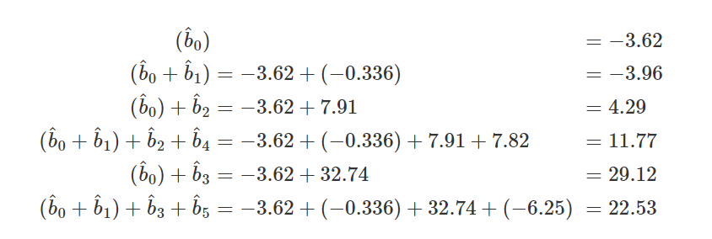
Exercise 7 (solution)
Stata Command
Concept
Formula
display _b[_cons]
Female reading
display _b[_cons]+_b[1.gender]
Male reading
display _b[_cons]+_b[1.prog]
Female jog
display (_b[_cons]+_b[1.gender])+ _b[1.prog]+_b[1.gender#1.prog]
Male jog
display _b[_cons]+_b[2.prog]
Female swim
Male swim
display (_b[_cons]+_b[1.gender])+ _b[2.prog]+_b[1.gender#2.prog]
Process
Start with the intercept b0, predicted weight loss for females
Get all the female effects (jog, swim)
Move to b0 + b1, predicted weight loss for males
Get all the male effects (jog, swim)
Think of male jog effect as additional effect for female jog
Think of male swim as additional effect for male swim

Slide 45
Exercise 8
Refer to the following model:
regress loss ib2.gender##ib3.prog
margins prog, dydx(gender)
Try to reproduce the interaction of male#jog

Slide 46
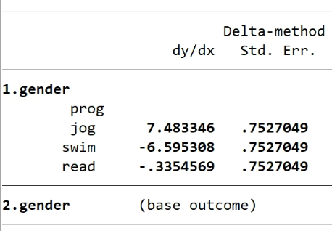
Solution to Exercise 8
margins prog, dydx(gender)
male effect for jog
Take the difference
male effect for read
display 7.483346-(-.3354569)
7.8188029
regress loss ib2.gender##ib3.prog

